Slide 1
Inverted Pendulum:
Swing-up, Balance, Catching
Raaghav Thirumaligai, Cole Giusto, Tien Nguyen
June 2, 2025

Slide 2
Heartbreaking backstory
u
θ₁
θ₂
g
g
The vibrational stabilization
The double cart pendula spring system
M
M

Slide 3
System Description
x
u
θ
System Objectives
g
Asymmetric metal rod with end pinned to cart
Encoder for angle of rod
Single Motor to drive cart
Encoder for position of cart
M
Stabilize downward equilibrium (for faster catching)
Stabilize upward equilibrium
State transition between equilibria

Slide 4
Model Identification
u
θ
g
Logarithmic Sine sweep ( ƒ ∈ [0.3, 3] Hz)
Tfest on 30 experiments to estimate linear model
Assumed integrator for cart, fit Voltage to Velocity model
Used 2 poles, 1 zero for cart, 3 poles 2 zeros for pendulum
M

Slide 5
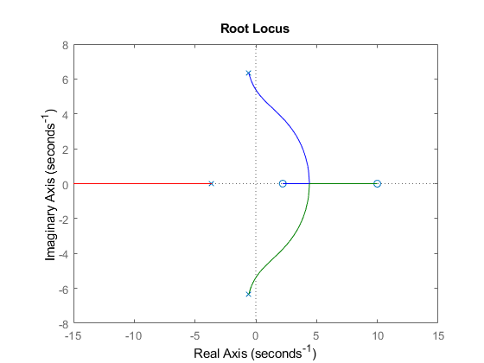
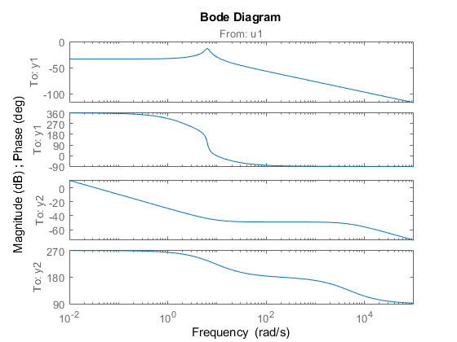
Identification of the stable equilibrium

Slide 6
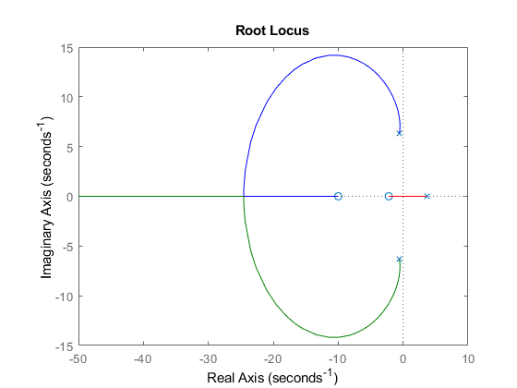
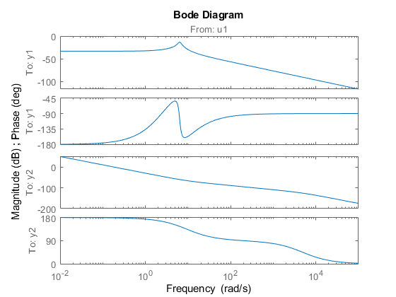
Modify for unstable equilibrium

Slide 7
State Machine
‘initialize’
Balancing Controller
θ near upright
θ outside upright region
Initial disturbance
Swing-Up Controller
Catching Controller
θ near straight down

Slide 8
Initialization
t = t_{n}
t < 0
θ = 0
θ
g
g
Accurate initial theta with gravity aligning the pendulum
Important to have accurate reading for inverted upward position
M
M

Slide 9
Swing Up Controller
t = t_{n}
u
|θ| > 0
Energy addition method:
Around every zero crossing of θ, the cart moves in direction opposite to the direction of the velocity to increase the energy in the pendulum
Continues until pendulum is able to fully “swing up”
Simple proportional controller regulates cart position
The activation is limited to a range θ ∈ [-30,30]° to try and reach inverted state with a small velocity
M

Slide 10
Balancing Controller
θ*
Activates upon state entering:
θ* ∈ [-23,23]°
Swing Up getting ‘close’
Stabilizes unstable equilibrium
Utilizes LQR/LQG with the model identified earlier to regulate both cart position and pendulum angle
Carefully tuned parameters to be as robust as possible
M
Note: θ* = θ mod(2π) - π

Slide 11
Catching Controller
θ
Activates upon state entering:
θ ∈ [-90,90]°
Pendulum Falls
Also utilizes LQR/LQG, this time to return to the bottom stable position
Brings pendulum back into predictable state to start Swing Up Controller
M

Slide 12
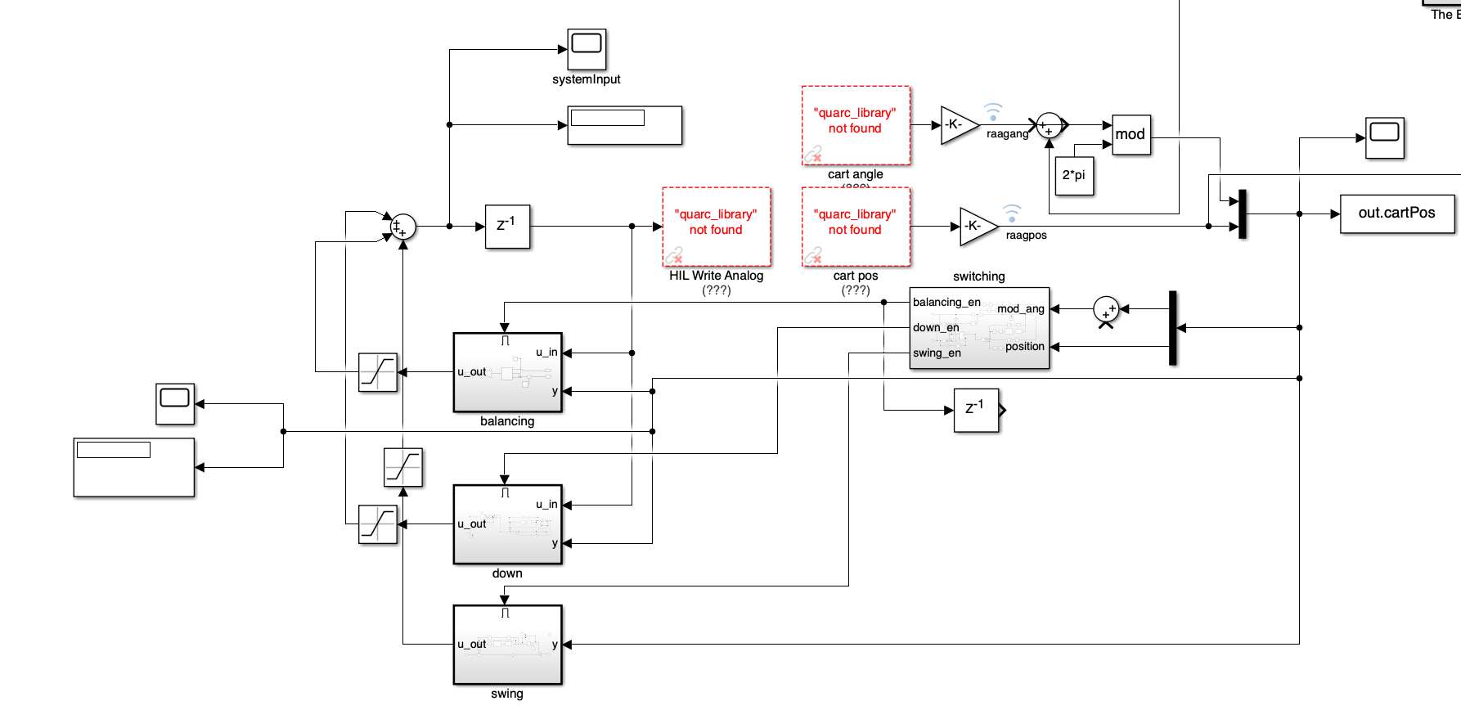
Full Controller

Slide 13
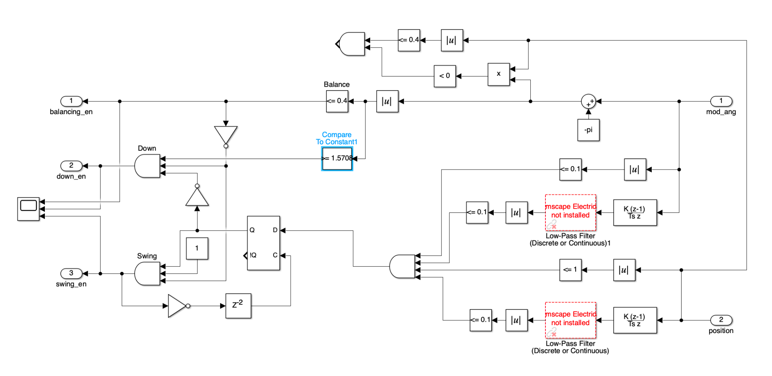
Switching

Slide 14
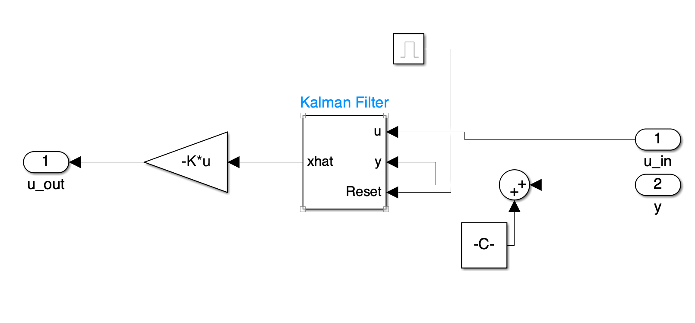
Balancing

Slide 15
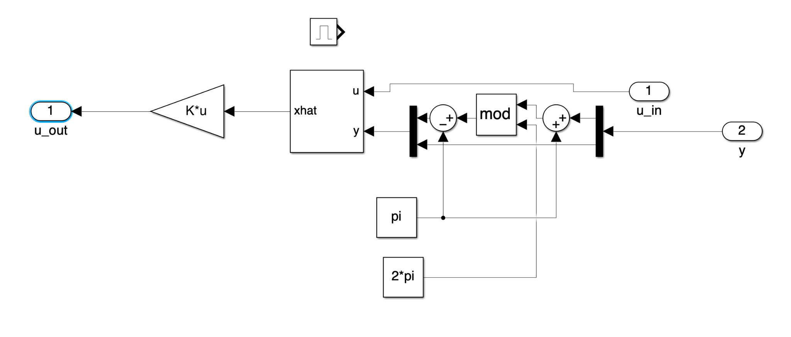
Catching

Slide 16
Demo:
Go to Lab Station
Go to Lab Station

Slide 17
Future Work
Introduce correction term to account for steady state error
More robust failure logic

Slide 18
Acknowledgement
Zeki
Joao

